Slide 1
Micro-programmed control
Control Memory
Address Sequencing
Micro-program Example
Computer Configuration
Microinstruction Format

Slide 2
Control memory
Control Memory (Control Storage: CS)
Storage in the micro-programmed control unit to store the micro-program.
Control word
It is a string of control variables (0’s and 1’s) occupying a word in control memory.
Micro-program
Program stored in control memory that generates all the control signals required to execute the instruction set correctly
Consists of microinstructions
Microinstruction
Contains a control word and a sequencing word
Control Word – contains all the control information required for one clock cycle
Sequencing Word - Contains information needed to decide the next microinstruction address

Slide 3
Control memory (contd..)
Writable Control Memory (Writable Control Storage: WCS)
CS whose contents can be modified:
Micro-program can be changed
Instruction set can be changed or modified
A computer that employs a micro-programmed control unit will have two separate memories: main memory and a control memory.
The user’s program in main memory consists of machine instructions and data whereas control memory holds a fixed micro program that cannot be altered by the user.
Each machine instruction initiates a series of microinstructions in control memory.

Slide 4
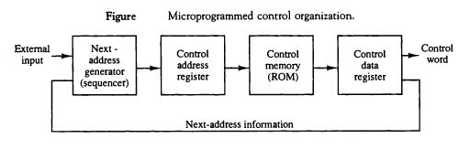
Control memory (contd..)
The general configuration of a micro-programmed control unit is demonstrated in the following block diagram:

Slide 5
Control memory (contd..)
Dynamic Microprogramming
Computer system whose control unit is implemented with a micro-program in WCS.
Micro-program can be changed by a systems programmer or a user
Control Address Register
Control address register contains address of microinstruction.
Control Data Register
Control data register contains microinstruction.
Sequencer
The device or program that generates address of next microinstruction to be executed is called sequencer.

Slide 6
Address Sequencing
Each computer instruction has its own micro-program routine in control memory to generate the micro-operations that execute the instruction.
Process of finding address of next micro-instruction to be executed is called address sequencing.
Address sequencer must have capabilities of finding address of next micro-instruction in following situations:
In-line Sequencing
Unconditional Branch
Conditional Branch
Subroutine call and return
Looping
Mapping from instruction op-code to address in control memory.

Slide 7
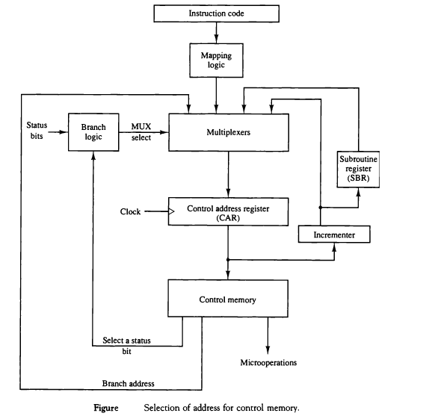

Slide 8
Address Sequencing (contd..)
Control address register receives address of next micro instruction from different sources.
Incrementer simply increments the address by one
In case of branching branch address is specified in one of the field of microinstruction.
In case of subroutine call return address is stored in the register SBR which is used when returning from called subroutine.

Slide 9
Conditional jumping
Simplest way of implementing branch logic hardware is to test the specified condition and branch to the indicated address if condition is met otherwise address resister is simply incremented .
If Condition is true, h/w set the appropriate field of status register to 1.
Conditions are tested for O (overflow), N (negative), Z (zero), C (carry), etc.

Slide 10
Unconditional Jumping
Fix the value of one status bit at the input of the multiplexer to 1.
So that, branching can always be done.

Slide 11
Mapping
Assuming operation code of 4-bits which can specify 16 (2⁴) distinct instructions.
Assume further, a control memory has 128 words, requiring an address of 7-bits. Now we have to map 4-bit operation code into 7-bit control memory address.
Thus, we have to map Op-code of an instruction to the address of the Microinstruction which is the starting microinstruction of its subroutine in memory.

Slide 12
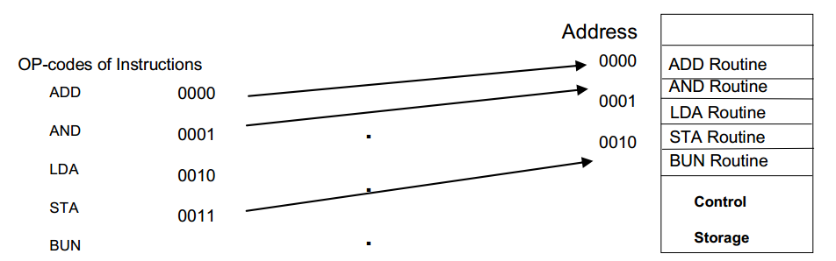
Direct mapping
Directly use opcode as address of Control memory

Slide 13
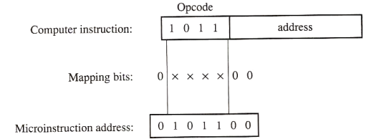
Another approach of direct mapping:
Transfer Op-code bits to use it as an address of control memory.
Fig: mapping from instruction code to microinstruction address

Slide 14
Extended idea: Mapping function implemented by ROM or PLD(Programmable Logic Device)
Use op-code as address of ROM where address of control memory is stored and than use that address as an address of control memory.
This provides flexibility to add instructions for control memory as the need arises.

Slide 15
Subroutines
Subroutines are programs that are used by another program to accomplish a particular task.
Microinstructions can be saved by employing subroutines that use common sections of micro code.
Example: the sequence of micro-operations needed to generate the effective address is common to all memory reference instructions.
Thus, this sequence could be a subroutine that is called from within many other routines to execute the effective address computation.
Subroutine resister is used to save a return address during a subroutine call which is organized in LIFO (last in, first out) stack

Slide 16
Micro-program (An example)
Once we have a configuration of a computer and its micro-programmed control unit, the designer generates the microcode for the control memory.
Code generation of this type is called micro-programming and is similar to conventional machine language programming.
We assume here a simple digital computer similar (but not identical) to Manos’ basic computer.
Computer configuration
Block diagram is shown below; it consists of two memory units: a main memory for storing instructions and data, and a control memory for storing the micro-program.
4 resisters are with processor unit and 2 resisters with the control unit.

Slide 17
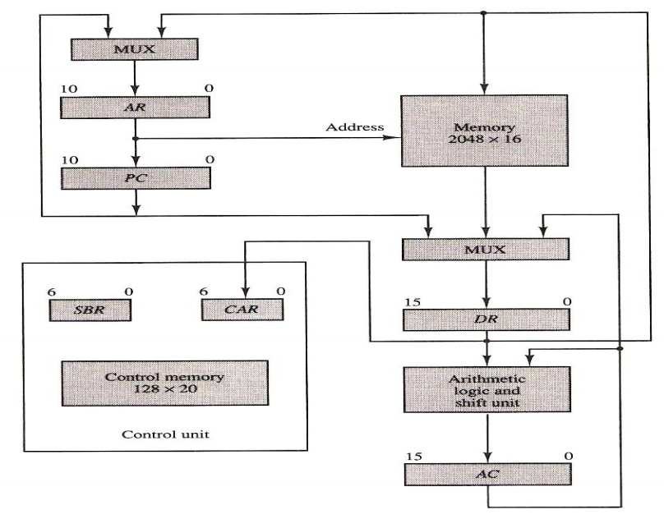

Slide 18
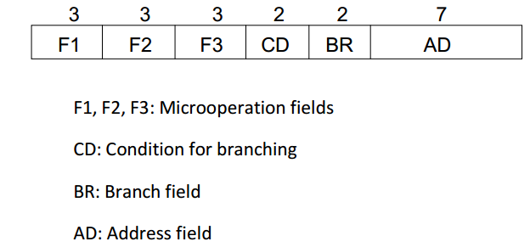
Microinstruction Format
Micro-instruction in control memory has 20-bit format divided into 4 functional parts as shown below.

Slide 19
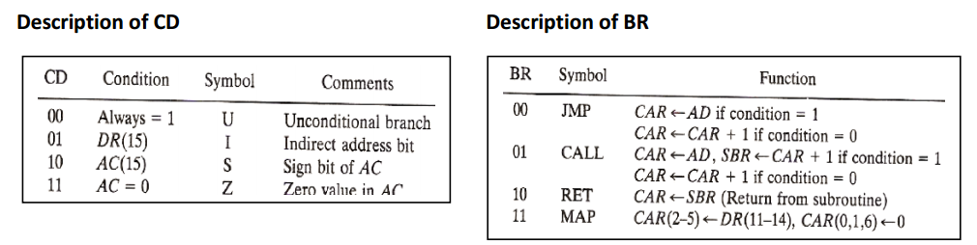
Microinstruction Format
Each micro-operation below is defined using resister transfer statements and is assigned a symbol for use in symbolic micro-program.
CD (condition) field consists of two bits representing 4 status bits and BR (branch) field (2-bits) used together with address field AD, to choose the address of the next microinstruction.

Slide 20
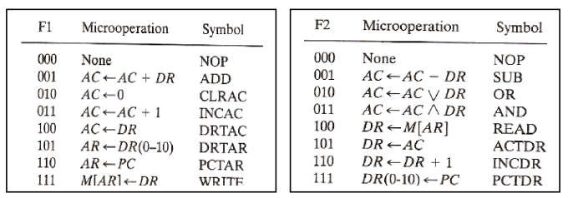
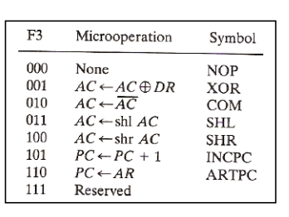
Microinstruction fields (F1, F2, F3)

Slide 21
Microinstruction fields (F1, F2, F3)
Micro-operations are subdivided into three fields of 3-bits each.
These 3 bits are used to encode 7 different micro-operations.
No more than 3 micro-operations can be chosen for a microinstruction, one for each field.
If fewer than 3 micro-operations are used, one or more fields will contain 000 for no operation.

